Slide 1





ENSIA
BOOSTING AGRICULTURAL COMPANY PROFITS: SALES DATABASE ANALYSIS (2012-2022)
DATA MINING PROJECT

Slide 2

ENSIA
TEAM MEMBERS
yaakoub salah eddine
arbaoui khedidja
benhamouche lydia
aiteur mouna

Slide 3




1.PROBLEM STATEMENT
The dataset belongs to an agricultural company and contains transactional records, including product details, pricing, sales, and payments. The goal of this analysis is to extract useful patterns to help the company boost sales and improve financial management

Slide 4
2.DATASET OVERVIEW
The dataset contains 261,001 entries, each belonging to a transaction. Below is a brief explanation of the key attributes:
CleEffet (int64) → transaction ID.
Date (object) → The date of the transaction.
TypeEffet (object) → Type of transaction
FamilleArticle (object) → Product category
Code Produit (object) → Internal product code.
Reference Produit (object) → Product reference identifier.
NLot (object) → Batch number of the product.
Produit_Designation (object) → Name or description of the product.
DetailEffet_Designation (object) → Additional transaction details.
Quantite (float64) → Quantity of the product involved in the transaction.
PrixAchat (object) → Purchase price of the product.
PrixUnitaireTTC (object) → Unit price including tax.
DetailEffet_Marge (object) → Specific margin details for the transaction.
Effet_Marge (object) → Overall profit margin.
MontantHT (object) → Total amount before tax.
Payement (object) → Amount paid for the transaction.

Slide 5
3.DATA PREPROCESSING STEPS
To ensure the dataset is clean and ready for analysis, we performed the following preprocessing steps:
1.First Notebook: General Data Cleaning
Step 1: Understanding the Dataset
Step 2: Handling Missing Values
Step 3: Data Type Conversion
Step 4: Handling Categorical Data
Step 5: Analysis of Column Importance
2.Second Notebook: Sales & Profit Analysis
Step 1: PrixUnitaireTTC
Step 2: MontantHT
Step 3: Payement
Step 4: PrixAchat
Step 5: DetailEffet_Marge and Effet_Marge

Slide 6
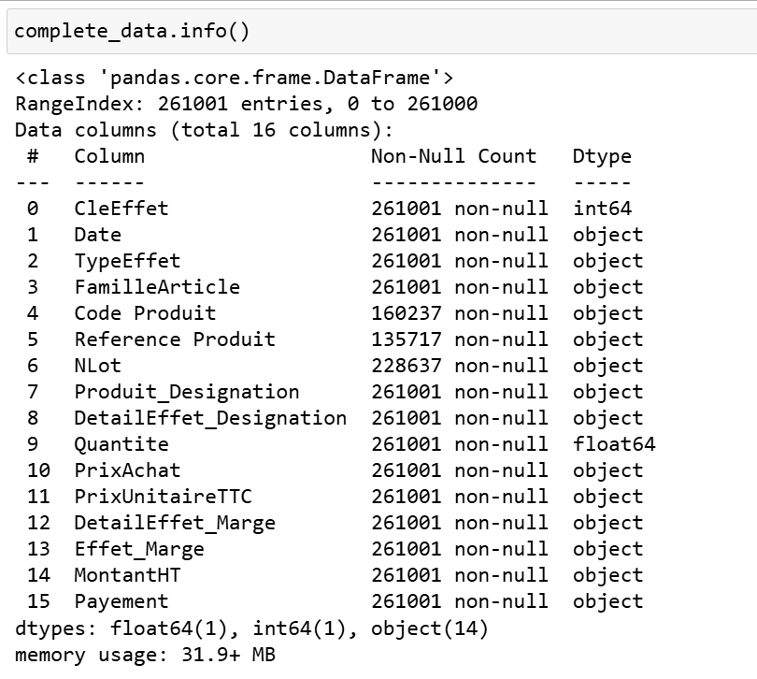
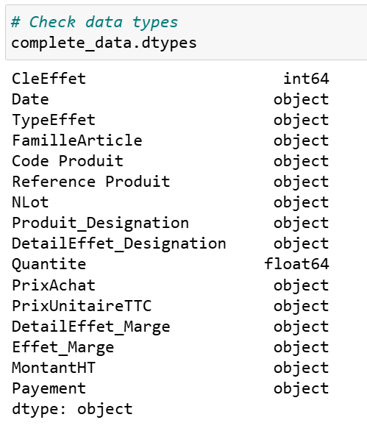
GENERAL DATA CLEANING
Step 1: Understanding the Dataset
Loaded the dataset and examined its structure using .info() and .describe().

Slide 7
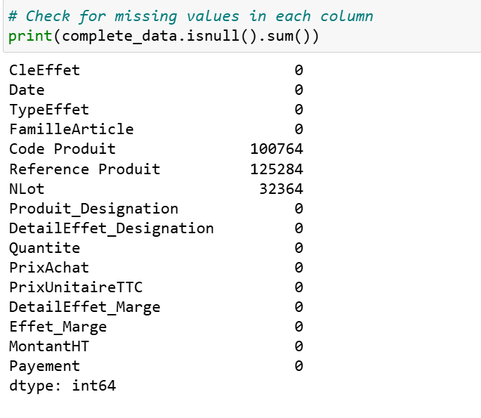
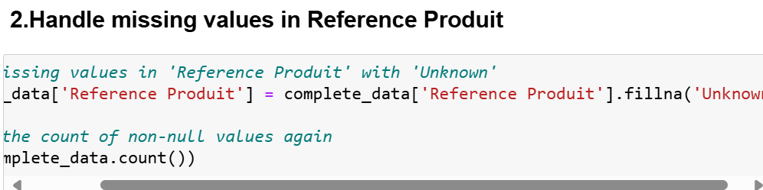
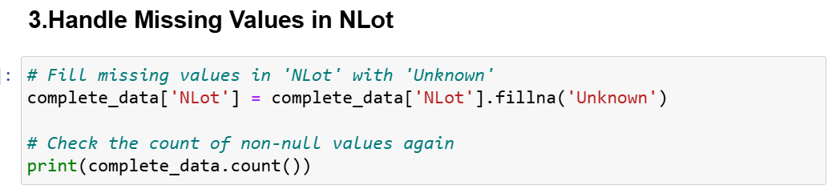
GENERAL DATA CLEANING
Step 2: Handling Missing Values
Identified missing values in key attributes like Code Produit, Reference Produit, and NLot.

Slide 8
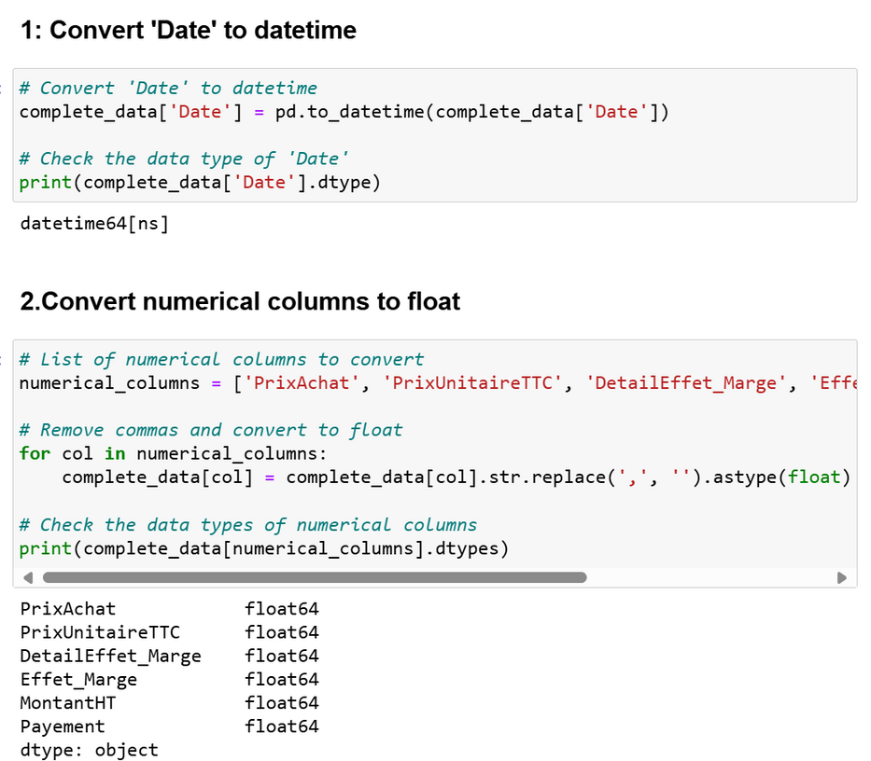
GENERAL DATA CLEANING
Step 3: Data Type Conversion
Converted numerical columns stored as objects (e.g., PrixAchat, PrixUnitaireTTC, Payement) into proper numeric types (float64).
Transformed the Date column into a datetime format to facilitate time-based analysis.

Slide 9
GENERAL DATA CLEANING
Step 4: Handling Categorical Data
1.Standardize 'FamilleArticle:unique 92 values that should be handled
Convert text to lowercase and remove extra spaces.
Identify inconsistencies by Print unique values and their counts.
Standardizing Prefixes: like semence,matériel,produit
Fix singular/plural inconsistencies
Fix specific typos, ex :semence pomme de tèrre' to semence pomme de terre'
Ensure consistent naming conventions (e.g., underscores vs. spaces)

Slide 10
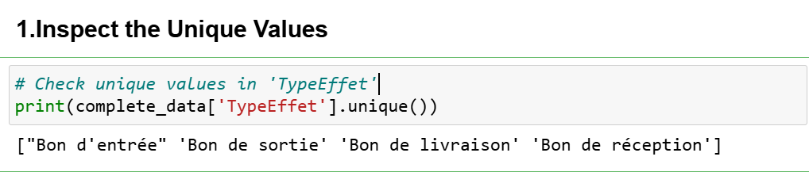
GENERAL DATA CLEANING
Step 4: Handling Categorical Data
1.Standardize 'TypeEffet'
seemed to have consistent values :["Bon d'entrée" 'Bon de sortie' 'Bon de livraison' 'Bon de réception']

Slide 11
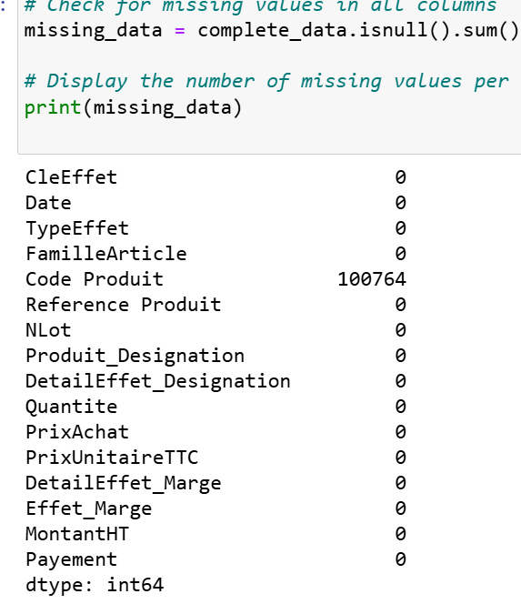
GENERAL DATA CLEANING
Step 5: Analysis of Column Importance
the colum code product had alot of missing values
Our approach
Assess Missing Values: The column contains a large number of missing values.
Check Uniqueness with Produit_Designation and DetailEffet_Designation
Decision: Since Code Produit is not a unique identifier and does not provide significant value for analysis, we choose to drop the column rather than removing rows with missing values, which could lead to unnecessary data loss.

Slide 12
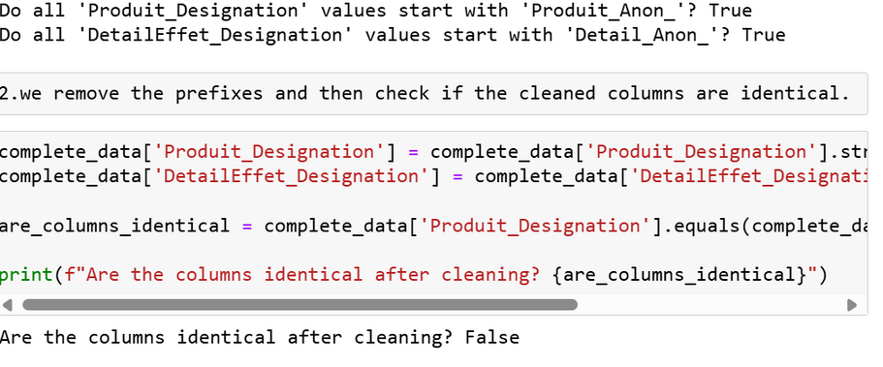
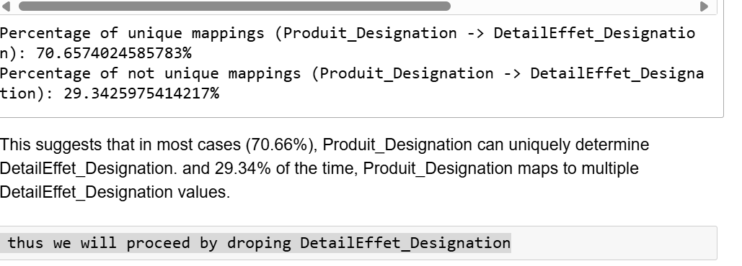
GENERAL DATA CLEANING
Step 5: Analysis of Column Importance
Assessing Produit_Designation and DetailEffet_Designation
Our approach
Checked that both columns had consistent prefixes, confirming they were anonymized similarly.
Removed the prefixes and found that the columns were not identical after cleaning.
Analyzed the uniqueness of DetailEffet_Designation for each Produit_Designation. We found that 70.66% of Produit_Designation values uniquely determined a DetailEffet_Designation.
Since Produit_Designation can determine DetailEffet_Designation in most cases, we decided to drop the DetailEffet_Designation column.

Slide 13
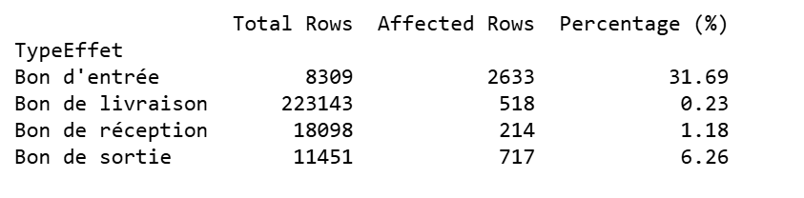
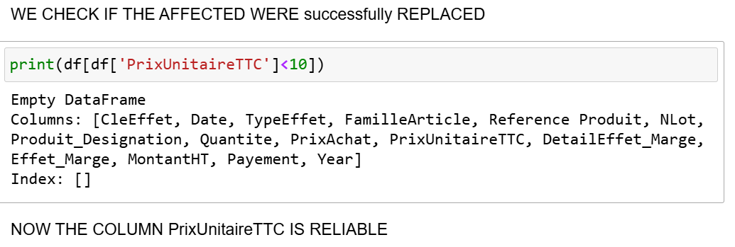
SALES & PROFIT ANALYSIS
Step 1: PrixUnitaireTTC
it representce the price of a unit of the product
Our approach
Analyzing the reliability of the "PrixUnitaireTTC" column by focusing on potential outliers (values under 10).
Replacing the corrupted values (i.e., those under 10) with the mean of each "FamilleArticle" for each year.

Slide 14
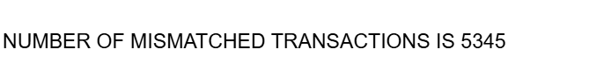
SALES & PROFIT ANALYSIS
Step 2: MontantHT
it representes Total amount before taxes
Our approach
Calculate Correct MontantHT USING CalculatedAmount=PrixUnitaireTTC*Quantite AND THEN WE COMPARE IT TO THE ACTUAL VALUES IN MontantHT to identify discrepancies (violations).
WE ADD THE "SALES" COLUMNS AS THE CALCULATED MONTANT

Slide 15
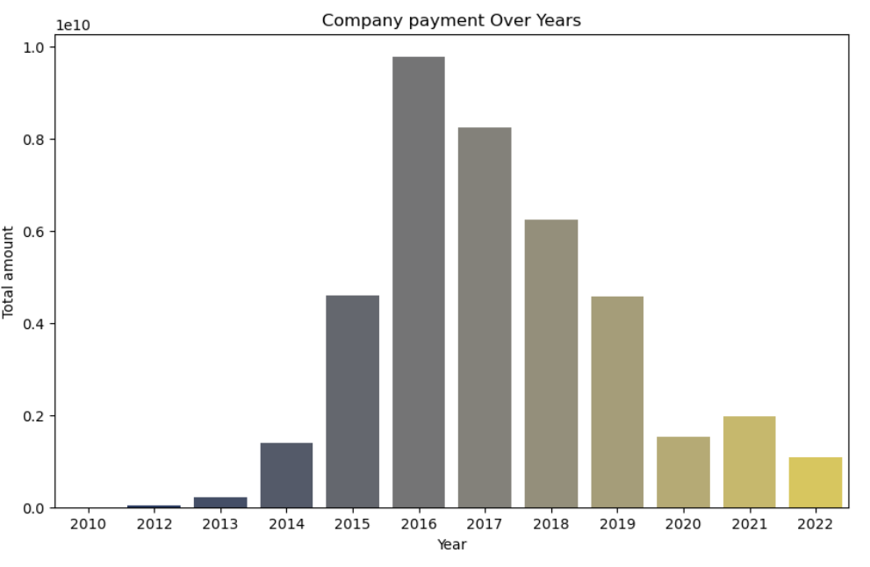
SALES & PROFIT ANALYSIS
Step 3: Payemenet
it wether the sold items where payed
Our approach
Comparing Payement and Sales: Calculated the difference between Payement and Sales.
Z-Score for Anomalies: Used the Z-score to flag values deviating significantly from the mean (threshold of 3).
Isolation Forest Model: Applied the Isolation Forest model to detect outliers in the payment difference.
Results: We detected 16 anomalies with Z-score and 4.99% anomalies using Isolation Forest. The total loss from anomalies was over 640 billion, highlighting the need for further investigation.

Slide 16
SALES & PROFIT ANALYSIS
Step 4: PrixAchat
it representes the purchase price
Our approach
Focus on Bon de Livraison Transactions: Focused on cleaning the PrixAchat for these specific transactions.
Handle Missing or Inconsistent Values: Used the IQR method to detect outliers and handle inconsistent values.
Replace Outliers: Replaced outliers with the median value of PrixAchat for non-anomalous data.

Slide 17
GENERAL DATA CLEANING
Step 5: PrixAchat
it representes the purchase price
Our approach
we correct DetailEffet_Marge column by directly calculating it
same for Effet_Marge

Slide 18
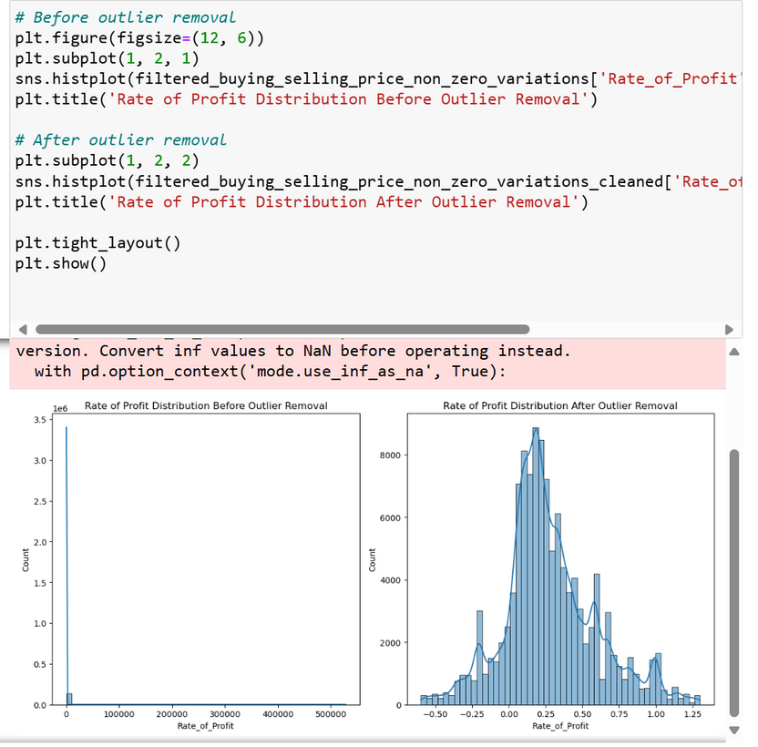
GENERAL DATA CLEANING
Step 6: calculating the rate of profit
Our approach
1. Identifying Products with Price Variations
2. Calculate Rate of Profit:(Selling Price - Buying Price) / Buying Price.
3. Identifying Outliers Using IQR
4.we removed the outliers
conclusion
we have improved the quality of our data, which will lead to more accurate and meaningful insights in future analyses. The transformation allows for better decision-making, as the cleaned data reflects more typical trends without being influenced by extreme values that could potentially lead to biased conclusions.

Slide 19
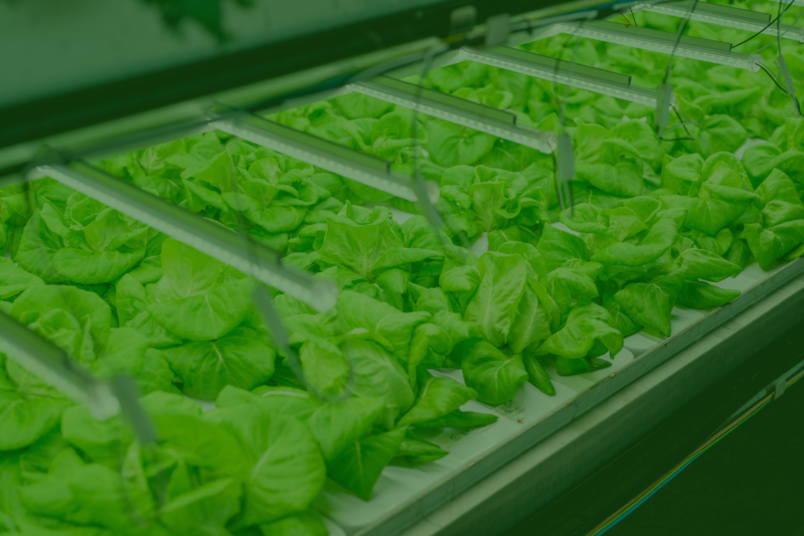

CLUSTERING
SEASONAL SALES ANALYSIS USING CLUSTERING

Slide 20
Dataset
PURPOSE
Sales data across different seasons.
Understand which seasons have the highest sales.
Identify which product families perform best in each season.
Use clustering to group sales patterns and derive insights.
Preprocessing
Converted dates into a readable format.
Extracted seasonal information from the dates.

Slide 21

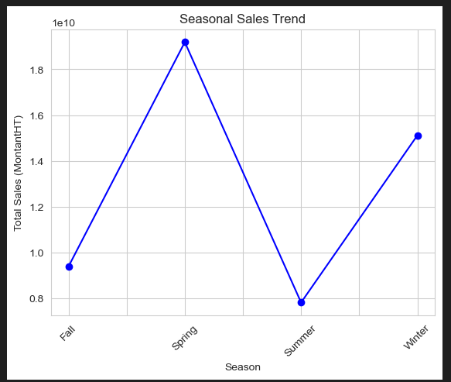
Compare seasonal sales based on the montant and conclude that sales are highest in spring and winter, while they are significantly lower in fall and summer.

Slide 22
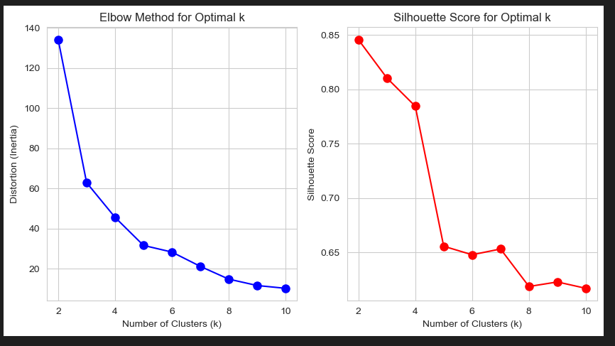
analyze sales trends across seasons using clustering to identify the optimal period for maximizing sales in each product family
Start by selecting the optimal number of clusters using the elbow method and silhouette score, then apply the clustering algorithm to analyze seasonal sales patterns.

Slide 23
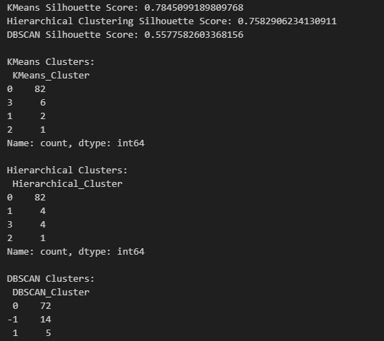
Silhouette Score measures the quality of clusters.
Apply three clustering algorithms and compute the silhouette coefficient to determine the most effective one. Based on the results, K-Means proves to be the best choice for further analysis.

Slide 24
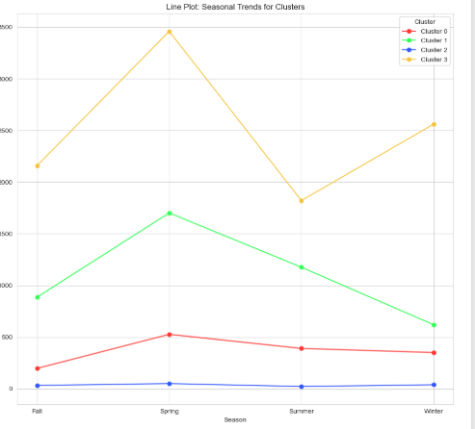
Clusters indicate clear seasonal trends in sales.

Slide 25
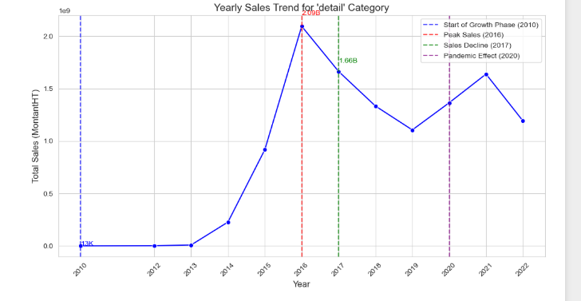
Based on the cluster analysis, we conclude that the product family with the highest sales is "Detail." Therefore, we will analyze this family revenue trends over time.

Slide 26
ASSOCIATION RULES

Slide 27

ASSOCIATION RULES
The goal of using association rules in this study is to identify frequent itemsets and recurring patterns over the years, ensuring their relevance. We focus on the autumn and summer seasons, where sales are weaker, to determine which items can drive higher sales for others when promoted. These insights help develop targeted strategies to boost sales during slow seasons..

Slide 28
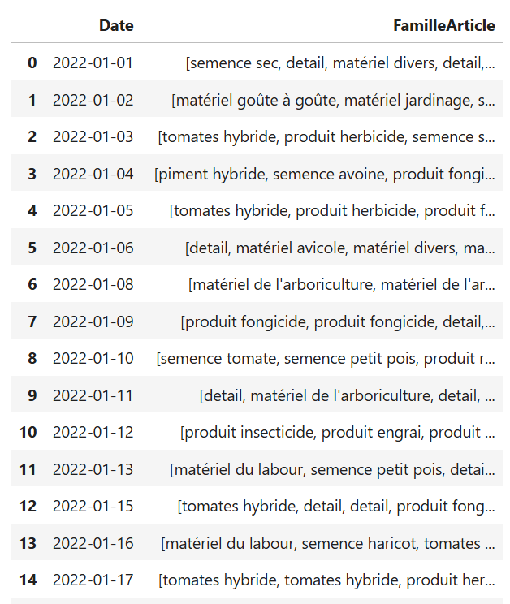
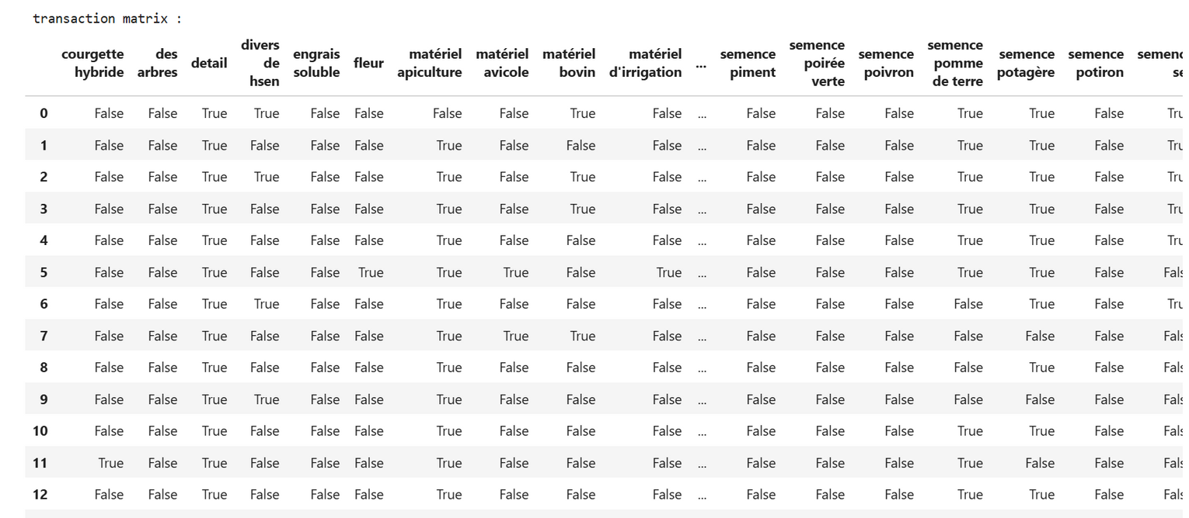
FRADEL AND SPIES
ALGORITHM USED
We used the Apriori algorithm.
Transactions were grouped by date and by the family type of the items sold on that date.

Slide 29
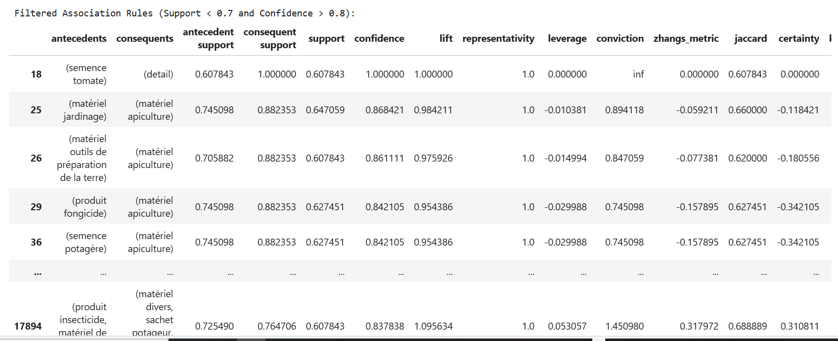
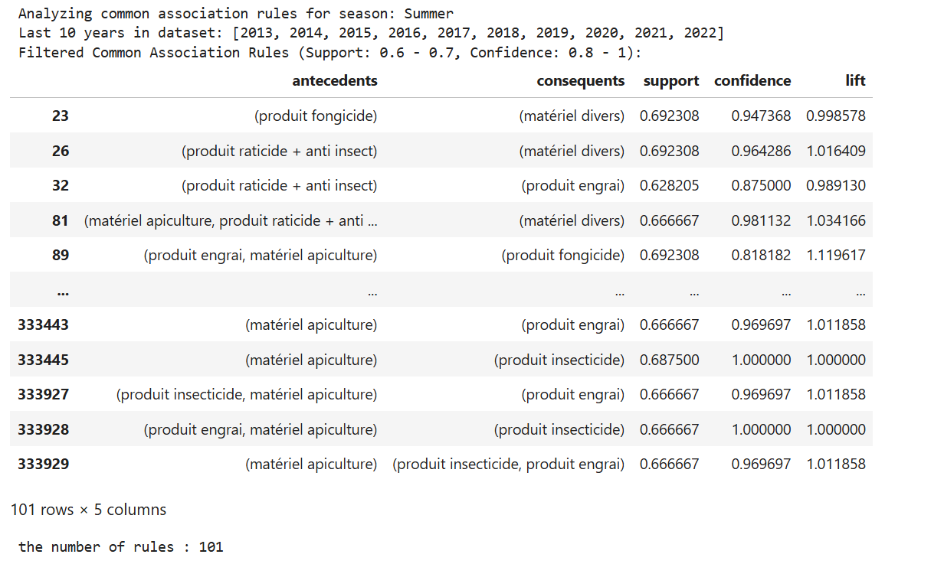
ALGORITHM USED
We developed an algorithm to generate association rules based on the season and year.
Another algorithm was designed to identify common rules that have been repeated over the past years.
We used these algorithms to analyze the association rules for Autumn and Summer, which are the seasons with weaker sales.
The generated common rules are stored in a CSV file, allowing the company to identify which item categories can drive higher sales.

Slide 30
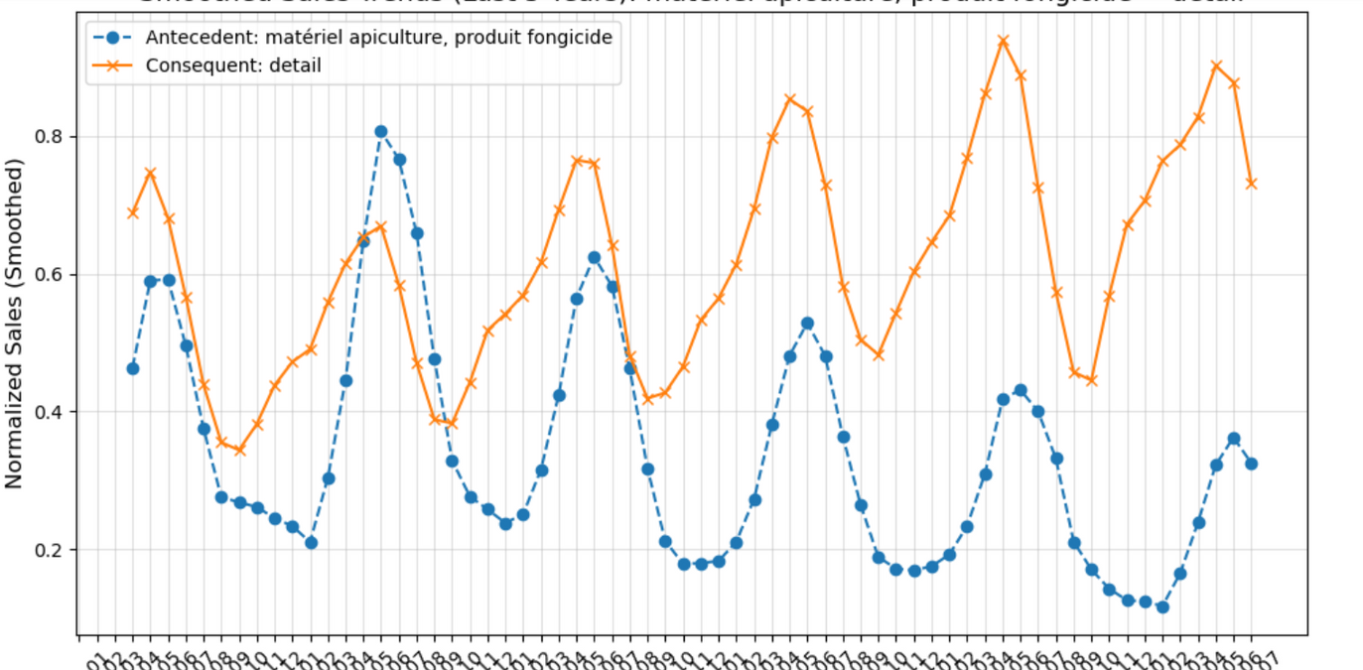
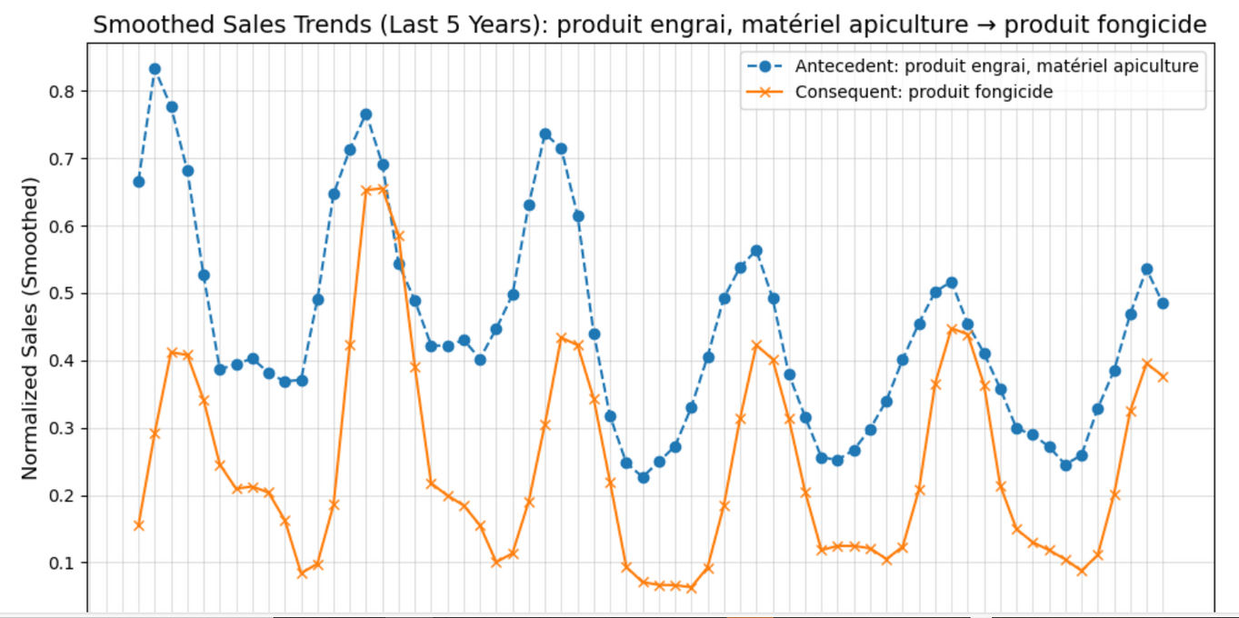
FRADEL AND SPIES
GRAPHS
We plotted graphs to compare the sales trends between antecedents and their consequents to ensure that they are strongly associated

Slide 31
ENSIA
THANK YOU

